Slide 1
Shuco Construction & Agriservices Inc. Web Application Project
By: Paul Pezold
7005981640

Slide 2
Business Context
Shuco Construction & Agriservices Inc. Web Application Project:
My company was recently contacted by Darrin Shumaker, the owner of Shuco. His company employs many people and provides a wide range of services. He wanted us to create a web application to replace his old company system. From his description, I, the Business Analyst, created the following diagrams to show to the project stakeholders, outlining the project requirements.

Slide 3
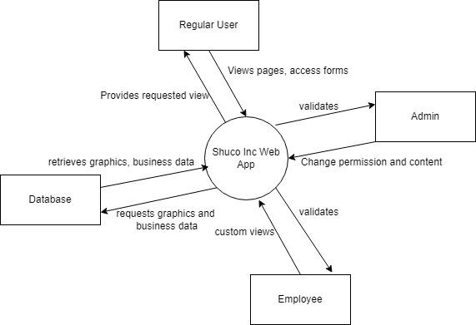
Context Diagram

Slide 4
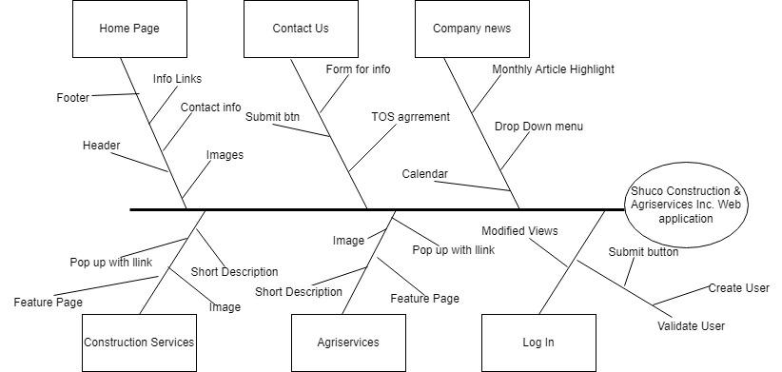
Feature Tree

Slide 5

Prototype Demonstration

Slide 6
Functional Requirements Discussion (selected)
Functional Requirements
# | Identifier | Description
1 | SYS.1 | The system will provide a page for each major service offered by Shuco, which are listed in their official “Services” document
14 | CON.1 | The system will provide a page “Contact Form” for non verified users to submit requests to the company
18 | LOG.3.2 | After the user has successfully logged in, the system will alter their view according to their user role. See the “System Roles” document for roles and their required views.

Slide 7
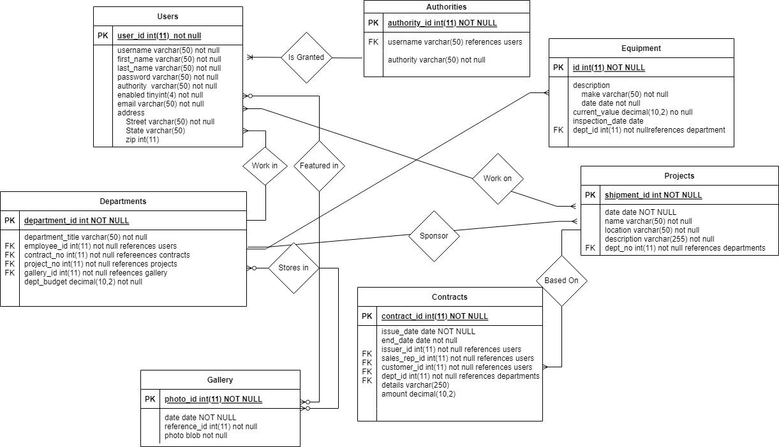
Data: ER Diagram

Slide 8
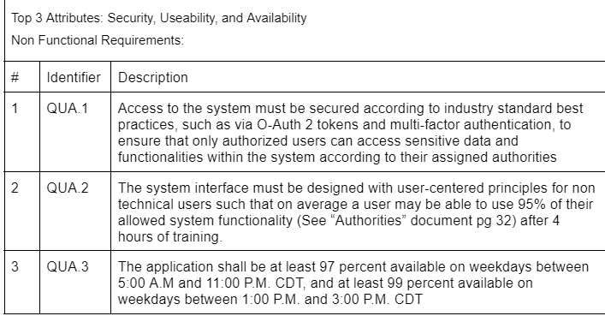
Quality Attributes

